Slide 1

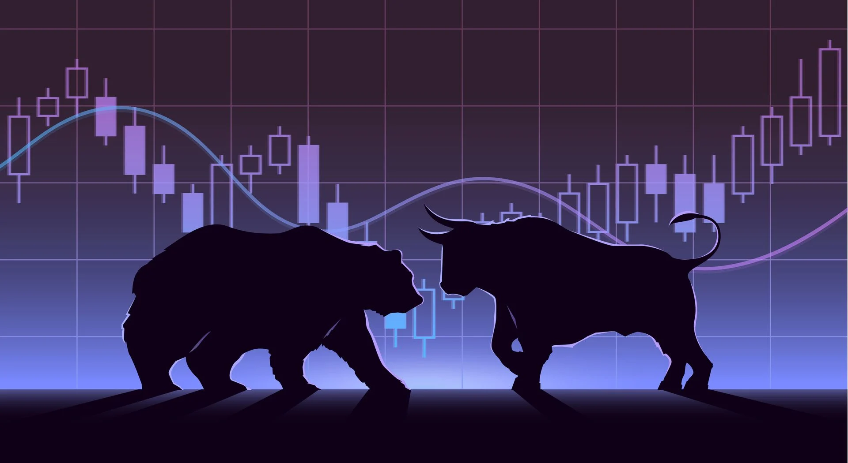
STOCK PRICE PREDICTION USING MACHINE LEARNING
STOCK PRICE PREDICTION USING MACHINE LEARNING

Slide 2
PRESENTED BY
SUCHISMITA DAS – 11200220039
SHARMISTHA SETT – 11200220040
PALLABI MAJI - 11200220043
DEBARATI PAUL – 11200220045
BANDANA BHARTI - 11200220046

Slide 3
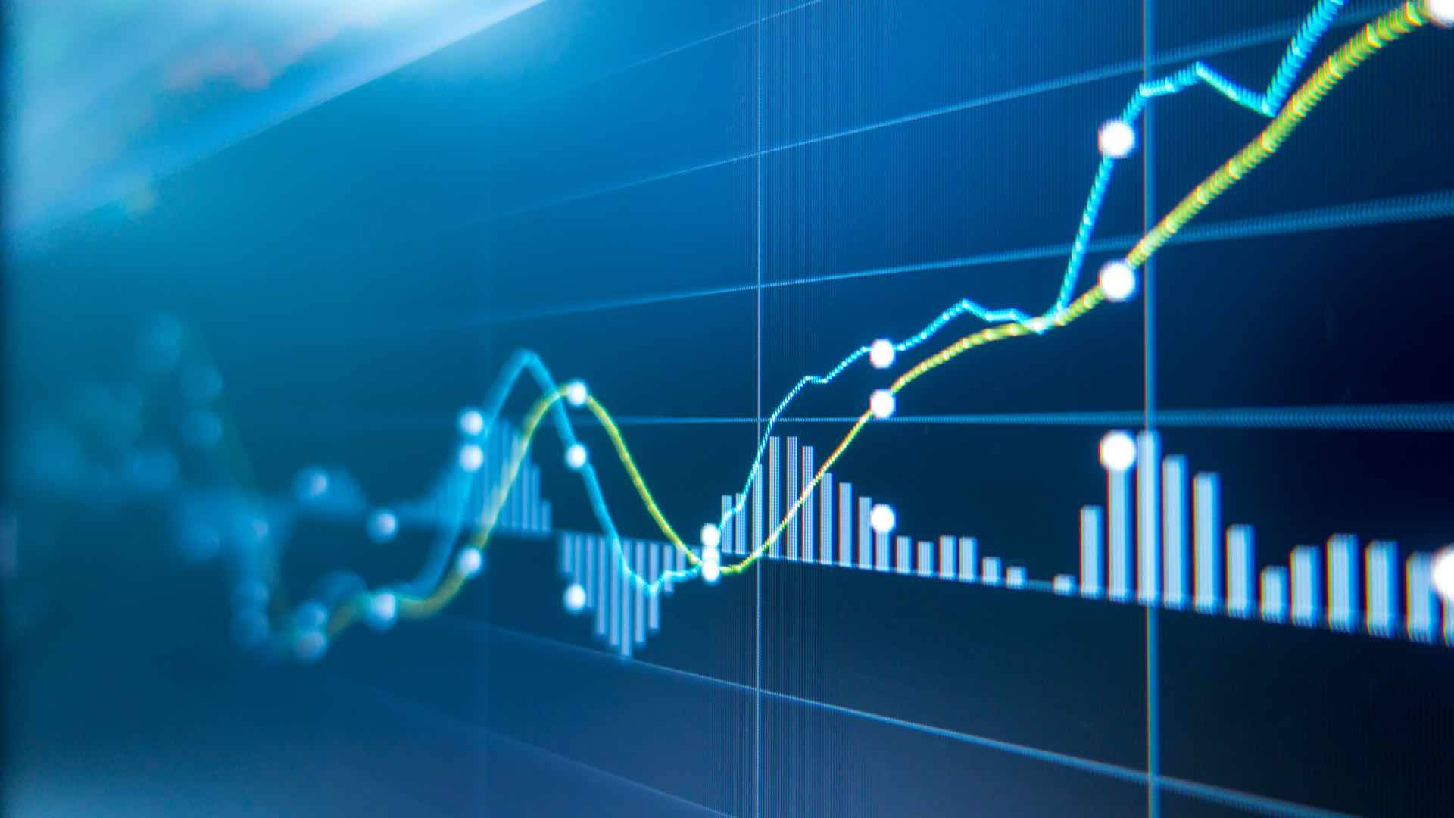
OUTLINE
GOAL OF THE PROJECT
DATASET DESCRIPTION
DATA PRE PROCESSING
DATA VISUALIZATION
MACHINE LEARNING MODEL
STOCK TREND PREDICTION EXAMPLE

Slide 4
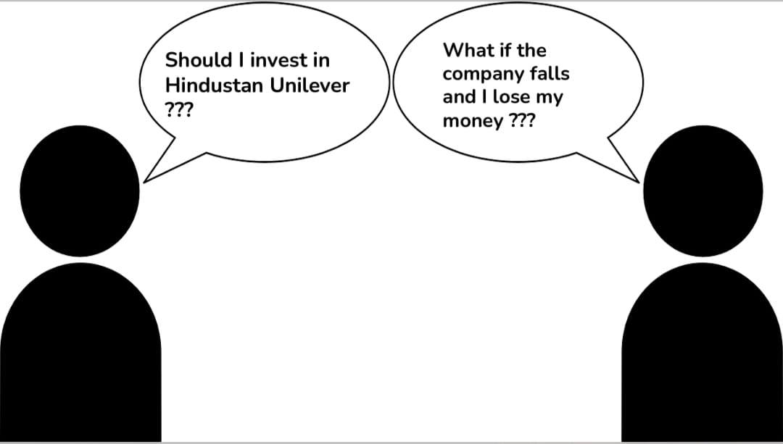
Should I invest in stock market………….!????
What if the companies falls and I lost all the money…????

Slide 5

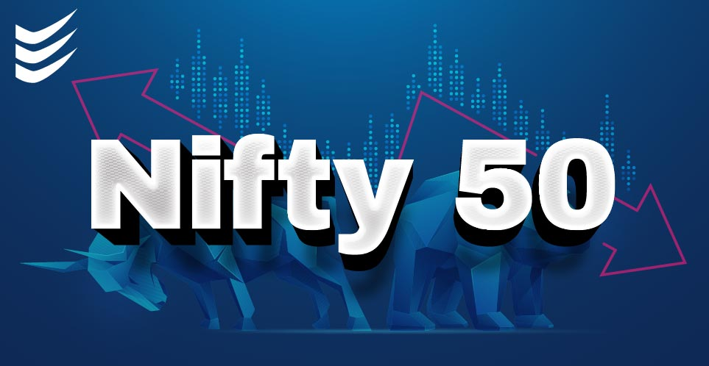
Goal of the project
Stock price prediction
This project proposes a method to predict Nifty 50 stock’s price for a trending day.
It is an attempt to determine whether the analysis of previous index of market can efficiently help in the calculation of closing market index of a trading day.

Slide 6

DATASET DESCRIPTION
Dataset is taken from Yahoo Finance through API connection .
The attributes of dataset are as follows: -
Date - Corresponding Date for stock values.
Open - Opening price of a stock on a particular day.
High - Highest selling stock value for a day.
Low - The lowest value of the selling price of a stock on a given day.
Close - Contains closing value of a stock on a given day.
Volume - The number of shares traded or brought on a given day.
Adj Close - The closing price of a stock after paying dividends to the investors.

Slide 7



FLOW CHART [BASIC]
Input : Stocks
Splitting train dataset
Fetch Data
Plot Data
Splitting test dataset
Save Model
Plot Predicted Results
Predict Stock
For n Days
Learn Model(using RNN through LSTM model
7

Slide 8
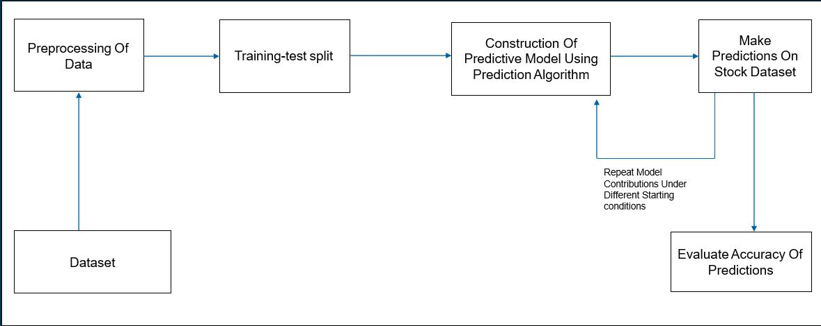
FLOW CHART [MAIN]

Slide 9
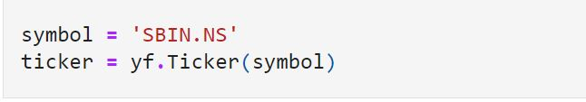
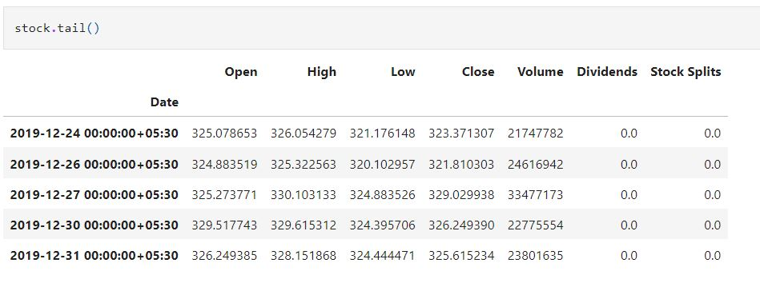
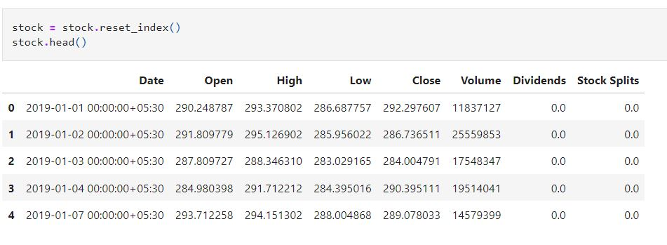
DATASET PRE PROCESSING
LOADING THE DATA FOR PRE PROCESSING

Slide 10
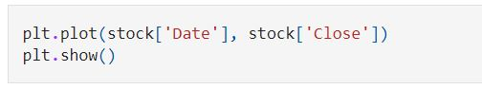
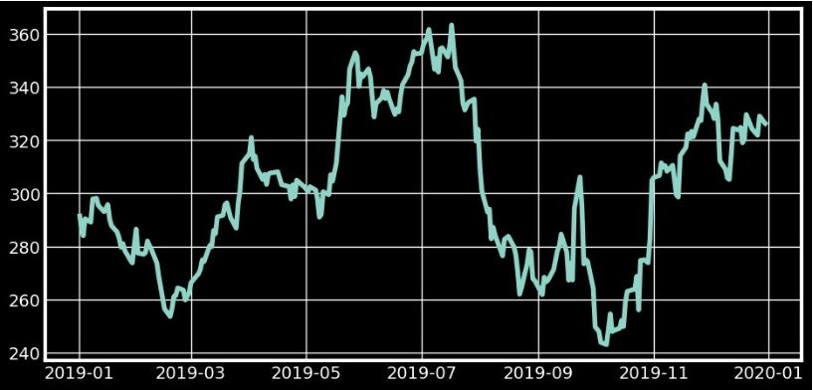
DATA VISUALIZATION
we can see the closing price vs time chart graph where X axis denotes time and Y axis denotes closing price.

Slide 11
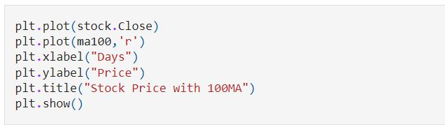
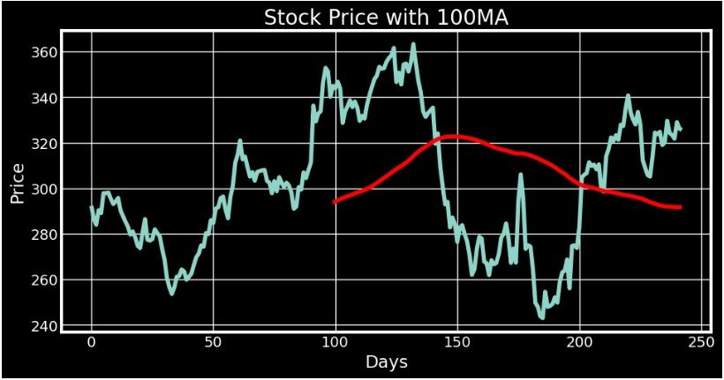
100 DAY’S MOVING AVERAGE
In this section we see the 100MA moving average. For the 100 days it not to able create any moving average. But for the 101 value we get the moving average .That is 101 index which will be just find the min of the previous 100 closing values and it will plot on the graph by using the rolling function.

Slide 12
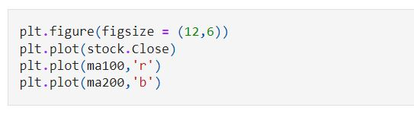
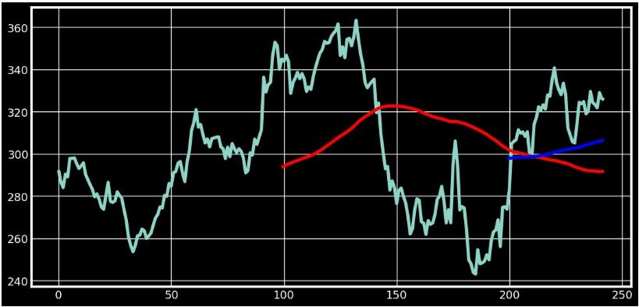
100 & 200 DAY’S MOVING AVERAGE
As the same of 100days moving average we find the 200days moving average. Here the first 200 day is null but for the 201 index the moving average value is there. So in this graph we see the both 100MA and 200MA together.

Slide 13
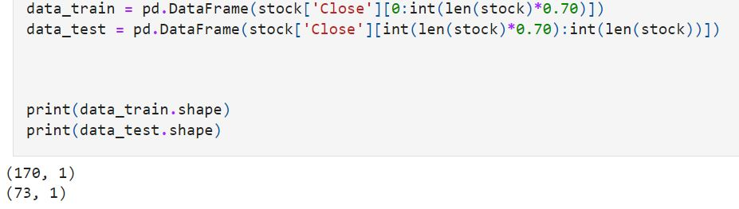
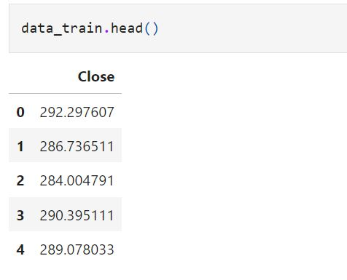
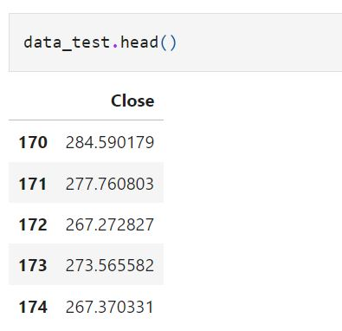
TRAININ *1QWWUIqG AND TESTING
Here, we have taken starting 70% of data for the training purpose and remaining 30% data for the testing purpose

Slide 14
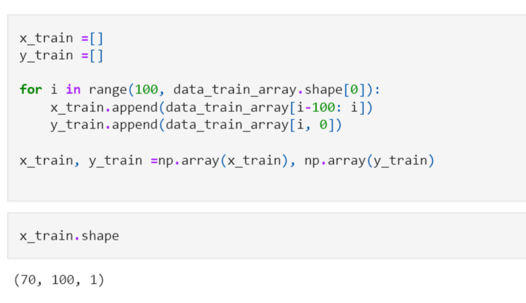
DATA TRAIN
X_train = first 100 days
Y_train =predicted value.
After getting first predicted value,the first predicted value will apend to the X_train for 100 days prediction and then will predict Y_train .

Slide 15
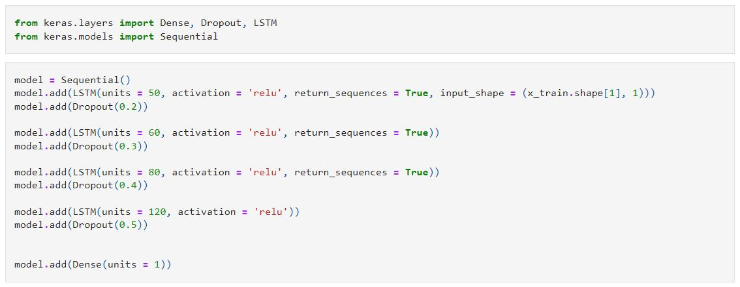
MACHINE LEARNING MODEL (LSTM MODEL)
Long Short Term Memory is a kind of recurrent neural network. In RNN output from the last step is fed as input in the current step.
We use four LSTM layers in our model and implement drop out in between for regularization. The number of units assigned in the LSTM parameter is fifty. with a dropout of 10 % should be 20%. Mean squared error is the loss function for optimizing the problem with adam optimizer. Mean absolute error is the metric used in our LSTM network as it is associated with time-series data

Slide 16
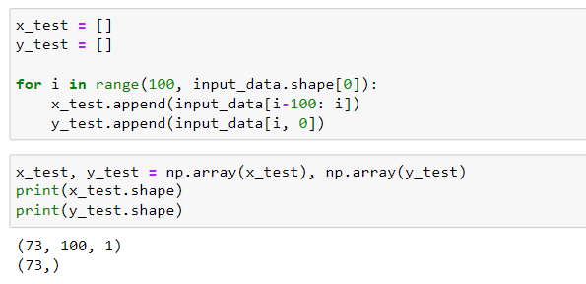
DATA Test
X_train = first 100 days
Y_train =predicted value.
After getting first predicted value,the first predicted value will apend to the X_train for 100 days prediction and then will predict Y_train .

Slide 17
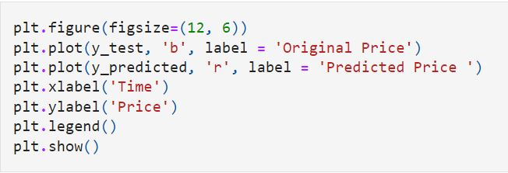
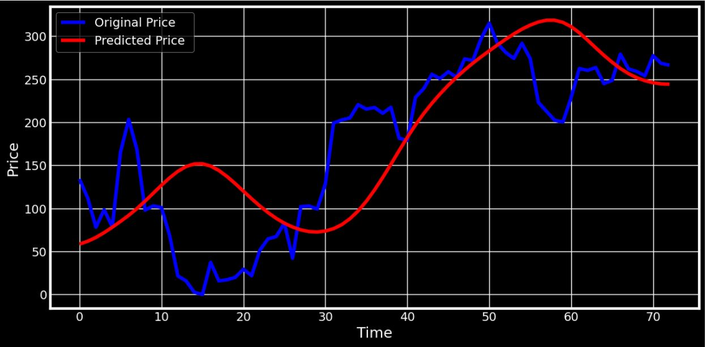
ORIGINAL PRICE vs PREDICTED PRICE WHILE MAKING PREDICTION
Here we are comparing the actual price vs predicted price given by the applications.

Slide 18
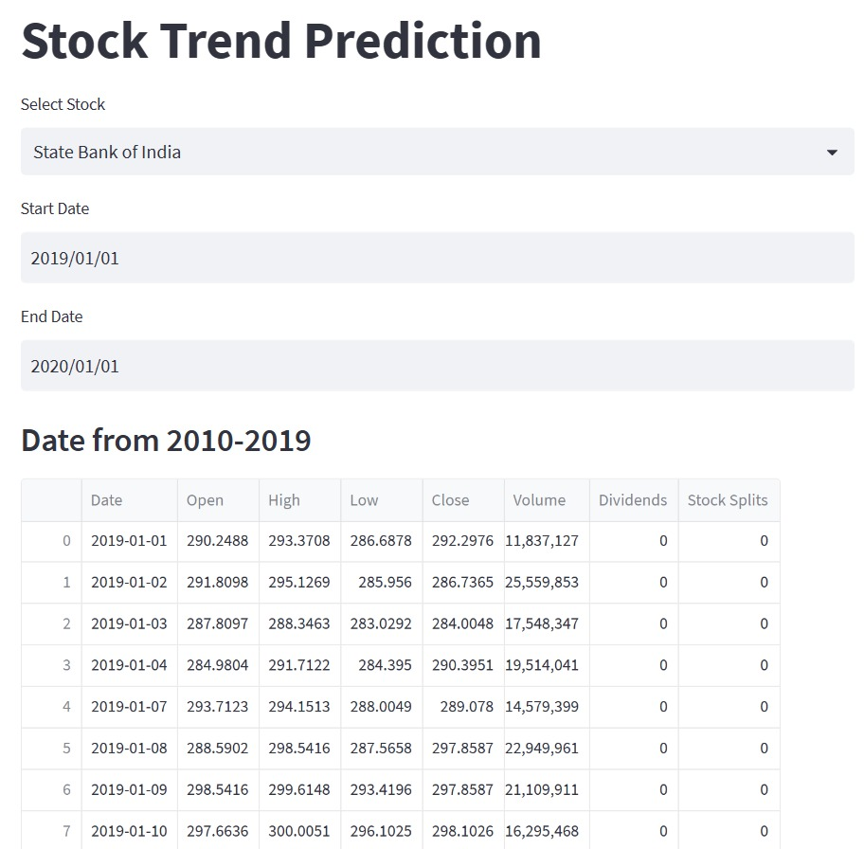
STOCK TREND PREDICTION WEB APPLICATION

Slide 19
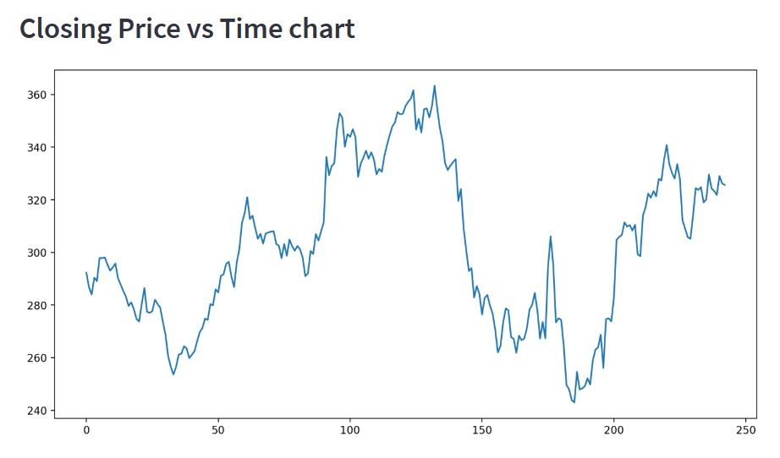
CLOSING PRICE vs TIME CHART (WEB PAGE GRAPH)
After fetching the data of the searched stock we got this graph

Slide 20
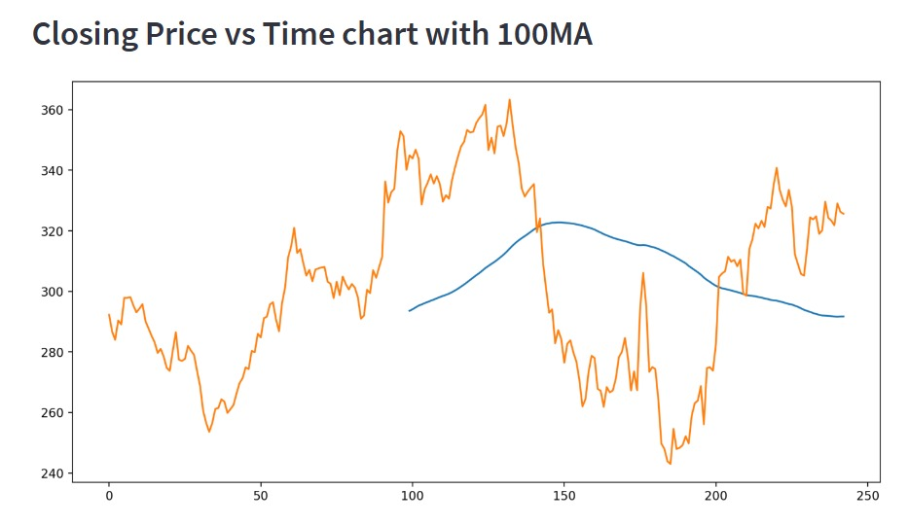
CLOSING PRICE vs TIME CHART (100MA)
After fetching the data of the searched stock we got this graph

Slide 21
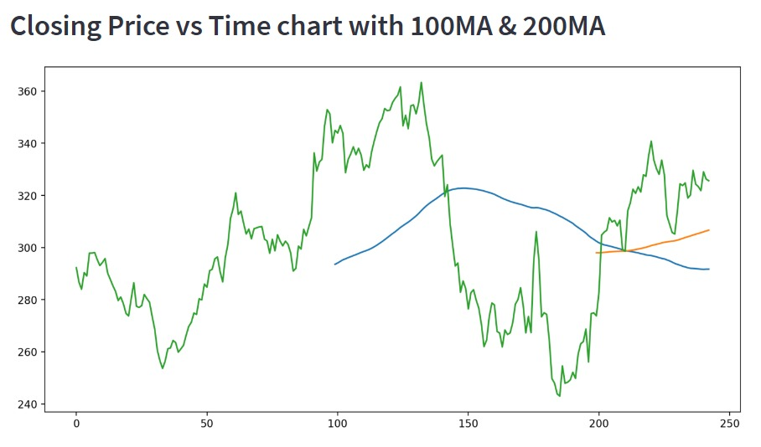
CLOSING PRICE vs TIME CHART (100MA AND 200MA)
After fetching the data of the searched stock we got this graph

Slide 22
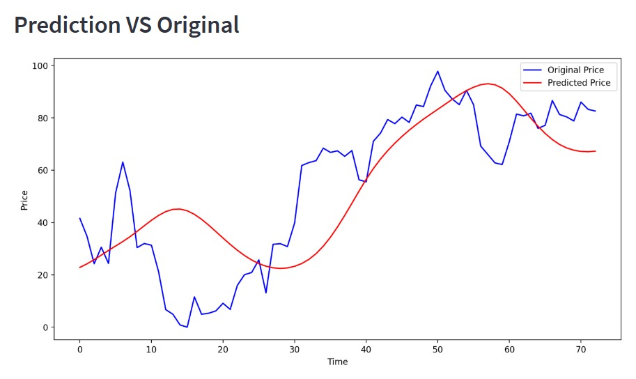
PREDICTED vs ORIGINAL
The prediction methods can be roughly divided into two categories , statistical methods and artificial intelligence methods. They used Long short -term memory network (LSTM).

Slide 23
Future Scope
Enhanced Predictive Models: Machine learning algorithms have already been applied to stock market prediction with varying degrees of success. We can explore advanced machine learning techniques such as deep learning, reinforcement learning, and ensemble methods to improve the accuracy and reliability of stock market predictions.
Integration of Alternative Data Sources: Traditionally, stock market prediction models have relied on historical stock price data and financial indicators. The future scope lies in integrating alternative data sources such as social media sentiment analysis, news sentiment analysis, satellite imagery, and web scraping. Incorporating these diverse data sources can provide additional insights and improve the predictive capabilities of machine learning models.

Slide 24
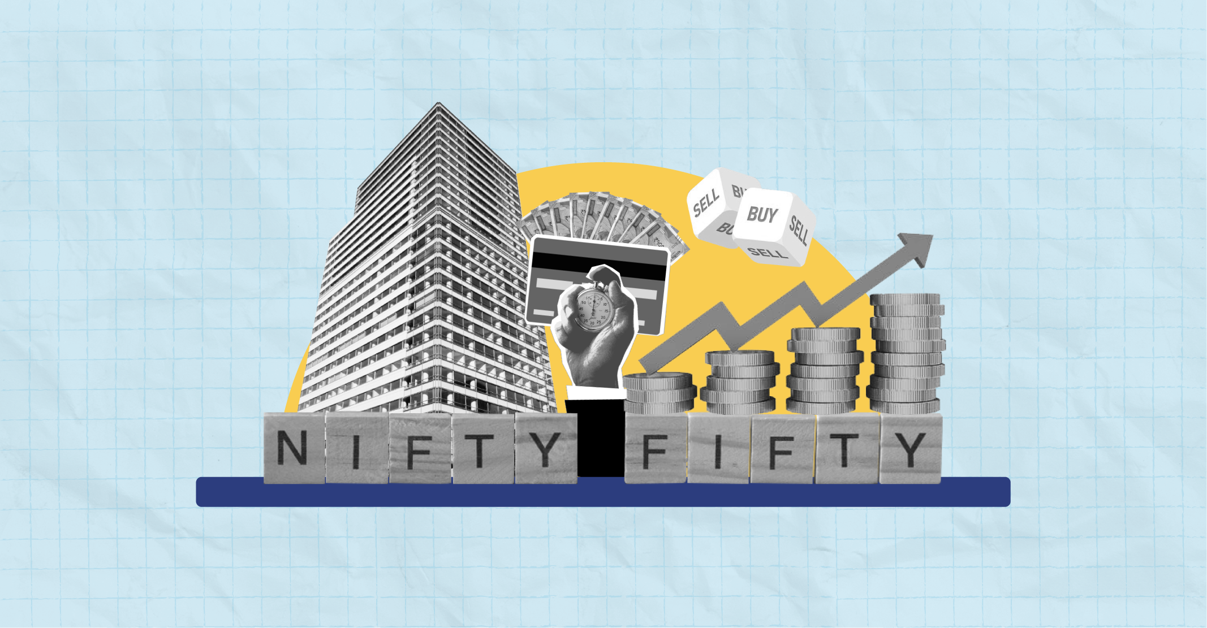
CONCLUSION
Two techniques have been utilized in this paper : LSTM and Regression, on the Yahoo finance dataset. Both the techniques have shown an improvement in the accuracy of predictions, thereby yielding positive results.
It has led to the conclusion that it is possible to predict stock market with more accuracy and efficiency using machine learning techniques.

Slide 25


